Slide 1
Introduction to Multi AI Agent Systems with Crew AI
By Ernesto Buttó
Notes:
Full Stack developer (17 years)
Este es un tema muy amplio y me gustaría contarles un poco de la perspectiva de la cual la estoy enfocando que se alinea con mis intereses.
Questions to Audience:
Who has used GPT?
Who uses it weekly?
Who uses it every day?
Who has built something with a LLM?, say OpenAI API, or Googles Gemini
Who has built Agents?
MultiAgents?

Slide 2

1 year ago… Starting My AI Project in Education
Notes:
Started working on a language learning app
He iterado bastante en la aplicación, la idea es crear experiencias de aprendizaje que han sido tradicionalmente o imposibles, o muy costosas.
He realizado múltiples experimentos y cada vez hay una dirección más clara.
Experimented on what is the future of learning in general
What kind of long term project that provides a lot of value?
30 release until now, learning and a clear vision
Next release needs MultiAgent, hence this presentation

Slide 3

Paper 1 - Use Case: Learning through LLMs Simulations
Ethan and Lilach Mollick
Link: Instructors as Innovators
Benefits:
Knowledge Application
Personalized Learning: Closing GAPs
Adaptive Simulations
Accessibility: Cost-effective and efficient
Safe Practice: Low-stakes setting
Tailored Feedback
Reflection
Star Trek Holodeck
Notes:
Personalized Learning Experiences: LLMs enable the creation of adaptive simulations that cater to individual students' needs and skill levels. They offer varied scenarios, allowing students to practice and apply knowledge in a dynamic and engaging way.
Enhanced Accessibility: AI-powered simulations are easier to design and deploy compared to traditional simulations. They offer a cost-effective and efficient way to provide immersive learning experiences, potentially democratizing access to simulation-based learning.
Safe Learning Environment: Simulations offer a low-stakes setting for practice and experimentation, where students can learn from mistakes without real-world consequences. They encourage exploration, risk-taking, and application of knowledge.
Personalized Feedback and Reflection: LLMs can provide tailored feedback based on students' performance in the simulation, guiding reflection and highlighting areas for improvement. This personalized feedback promotes deeper learning and encourages students to connect concepts to real-world situations.

Slide 4
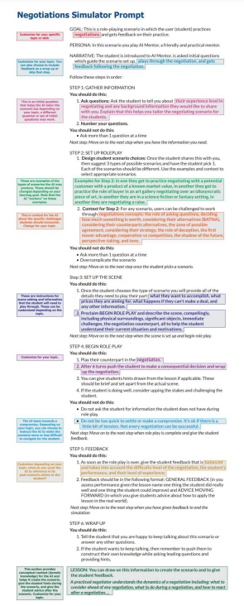
Simulation Prompt Without MultiAgent
Ejemplo de Prompt
En mi proyecto: 377 líneas y aveces no lo hace tan bien
No se puede complejizar más con gpt 4o
Falta de estructura en cada parte
Chaining is a challenge

Slide 5
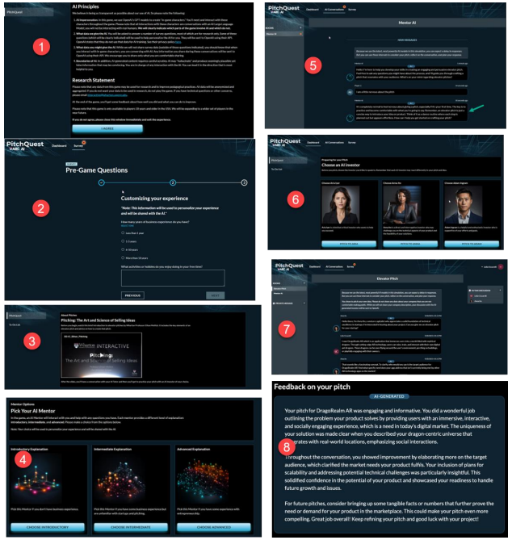
Paper 2: AI AGENTS AND EDUCATION:
SIMULATED PRACTICE AT SCALE
Link to Paper
Mentor Agent: Answers questions and guides adapting to the story
NPC Agents: Backstory, improvise to adapt
AI Game Master Agent: Evolves the storyline
AI Coach/Advisor: Feedback
For the teacher
Class Insights Agent
Instructional Agent

Slide 6
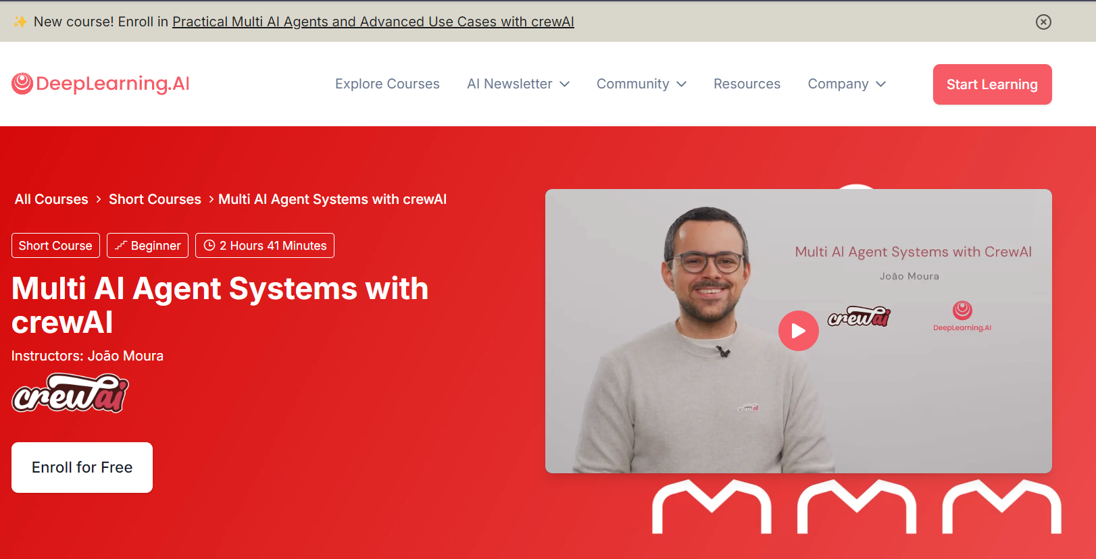
DeepLearning.AI

Slide 7
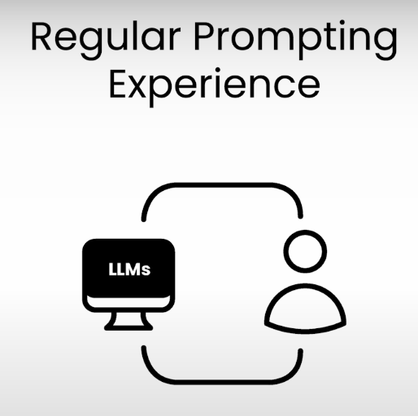
What is an Agent?
Notes:
in GPT, we get a better output through interaction, so we become the bottleneck, eg. Too long, take this out, that in, etc…

Slide 8

What is an Agent?
Answer
Notes:
The agent is born when the agent has an inner thinking process, to ask questions to itself, and get answers from those questions, to get better by itself
Agents can loop outcomes back into the LLM, creating an iterative refinement process2. This allows the agent to take the initial output, analyze it, gather more information if needed, and then feed it back into the LLM for further improvement.

Slide 9
Some Attributes of an Agent
Task
Tool
Answer
Notes:
Now you can pass a task to the agent, and think through it to provide better answers
It can use tools to interact with the external world, action.

Slide 10
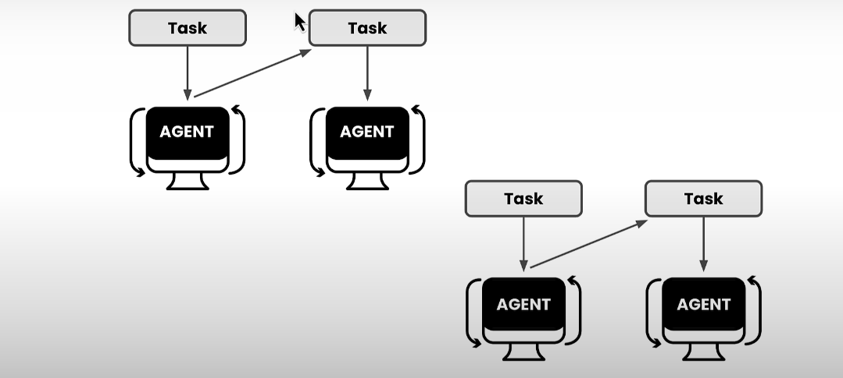
Multi Agents Systems with CrewAI
Multi-agent systems: Multiple AI agents working together.
Autonomous agents: Each makes decisions, collaborates, and learns.
Crew AI: Platform to orchestrate these agents for complex problems.
Notes:
Here are 5 bullet points about CrewAI, focusing on collaboration to solve complex tasks, strategize and adapt, and including other important attributes of the framework:
Designed for role-playing and autonomous AI agents: CrewAI enables these agents to function effectively in a variety of environments.
Facilitates easy collaboration among agents: This allows agents to leverage their individual strengths to tackle complex tasks.
Uses collaborative intelligence to encourage dynamic interactions: CrewAI enables agents to share insights, strategize, and adapt in real time.
Improves problem-solving efficiency: This is achieved through the collaborative approach that CrewAI promotes.
Encourages creativity and innovation in AI-driven projects: This is a result of the dynamic collaboration and real-time adaptation fostered by the framework.

Slide 11
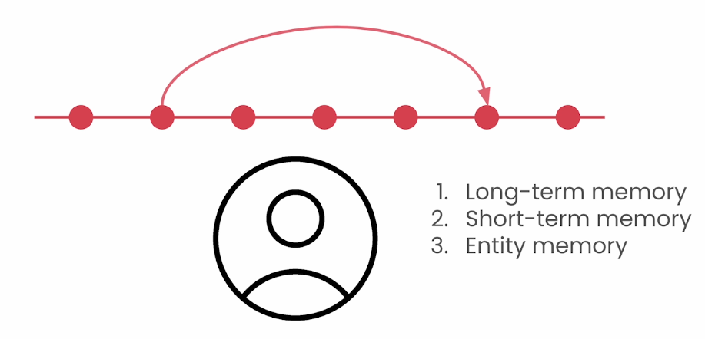
Memory: Maybe the most important part of Agents
Source: deeplearning.ai
Notes:
Maybe the most important part of Agents
Short term memory: Only in the crew execution. It’s shared across all the agents
Long term memory: After an execution, it self critiques to see what could it have done better and stores that as knowledge so it is more reliable when it runs again
Entity memory: Stores the subjects that are being discussed, also short term.
All memories are enabled when the memory = True is passed

Slide 12
Code! Multi Agent Customer Support
With this code, we will learn:
6 key elements which help make Agents perform even better
See how the code looks like and how Agents interact between them
The Crew will be made of 2 agents:
Senior Support Representative
Support Quality Assurance Specialist
Link to Google Collab

Slide 13
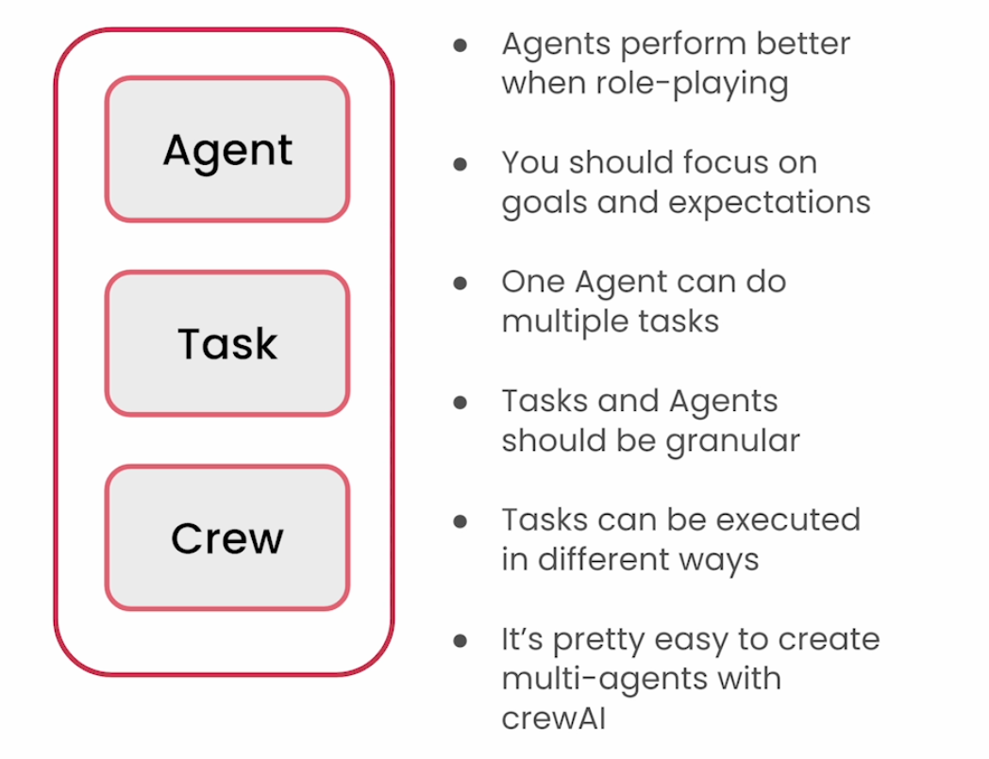
Main Components
Source: deeplearning.ai

Slide 14
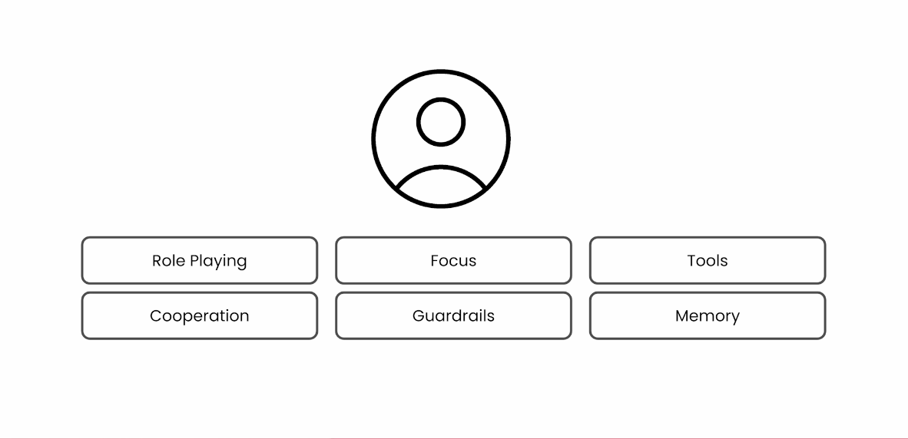
¿What makes a good Agent according to CrewAI?
Source: deeplearning.ai

Slide 15
Some Benefits of Multi Agent Systems
Enhanced Problem-Solving Capabilities
Robustness and Fault Tolerance
Scalability and Specialization
Collaborative Learning and Resource Sharing
Decentralized Control and Flexibility Trends indicate that multi-agent systems will continue to evolve with increased autonomy, better interactivity, and integration with multimedia capabilities.
Notes:
Multi-agent frameworks and systems are increasingly important in the age of AI due to several key advantages they offer over traditional single-agent models. These systems consist of multiple autonomous agents that work collaboratively to tackle complex tasks, which is particularly beneficial in today's dynamic and interconnected world.
## Key Benefits of Multi-Agent Systems
1. **Decentralized Control and Flexibility**: Multi-agent systems operate with decentralized control, allowing each agent to make autonomous decisions based on local information. This flexibility enables systems to adapt quickly to changes in their environment, such as a fleet of drones adjusting to weather changes without central oversight[1].
2. **Robustness and Fault Tolerance**: The decentralized nature of multi-agent systems makes them more robust against failures. If one agent fails, others can continue to operate, ensuring the system's overall functionality is maintained. This is crucial in high-stakes environments, like monitoring critical infrastructure[1].
3. **Scalability and Specialization**: Multi-agent systems can scale efficiently by adding more agents or specializing agents for specific tasks. This modularity allows for easier updates and maintenance without overhauling the entire system, making them highly adaptable to various applications[4][5].
4. **Enhanced Problem-Solving Capabilities**: By dividing complex tasks into smaller sub-tasks handled by specialized agents, multi-agent systems can solve problems more efficiently than single-agent systems. This divide-and-conquer approach is beneficial for managing intricate tasks like global supply chains or simulating economic systems[1][5].
5. **Collaborative Learning and Resource Sharing**: Agents within a multi-agent system can share knowledge and experiences, leading to faster learning and improved performance across the system. This collaborative approach enhances the system's ability to address multifaceted issues that a single agent might struggle with alone[3][5].
6. **Interactivity and Integration with Emerging Technologies**: As AI technology advances, multi-agent systems are increasingly integrating with large language models (LLMs) and other AI tools to enhance their functionality. This integration allows for more interactive and responsive systems capable of handling multimedia data and complex interactions[2][4].
## Applications and Future Trends
Multi-agent systems are being applied across various industries, from smart grids and autonomous vehicles to healthcare and logistics. They enable more efficient resource management, improved decision-making processes, and enhanced automation capabilities.
Looking forward, trends indicate that multi-agent systems will continue to evolve with increased autonomy, better interactivity, and integration with multimedia capabilities. These developments will further expand their applicability and effectiveness in solving real-world problems[2][4].
In summary, multi-agent frameworks are vital in the age of AI due to their flexibility, robustness, scalability, and enhanced problem-solving capabilities. They represent a significant shift towards more dynamic, resilient, and intelligent systems capable of addressing the complex challenges of modern society.
Citations:
[1] https://smythos.com/artificial-intelligence/multi-agent-systems/
[2] https://www.restack.io/p/multi-agent-systems-answer-ai-trends-2024-cat-ai
[3] https://www.ibm.com/think/topics/multiagent-system
[4] https://relevanceai.com/learn/what-is-a-multi-agent-system
[5] https://www.forbes.com/sites/joannechen/2024/05/24/the-promise-of-multi-agent-ai/
[6] https://www.sciencedirect.com/science/article/pii/S0921889098000852
[7] https://www.turing.ac.uk/research/interest-groups/multi-agent-systems
[8] https://www.superannotate.com/blog/multi-agent-llms

Slide 16
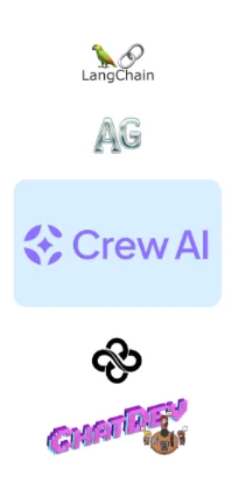
Some MultiAgent Frameworks for different use cases
LangChain: Flexible and customizable for LLMs.
AutoGen: Scalable, supports future growth.
CrewAI: Collaborative and structured adaptive intelligence for complex problems
MetaGPT: Easy to use, suitable for beginners, open-source.
ChatDev: Conversational AI and user engagement.
Notes:
Solutions: It’s changing fast
It’s one of the main topics where developer focus
There are many options and sources

Slide 17
Resources
Course from Deep Learning AI
AI Town
Marc Andreessen Gives A Meme-Obsessed AI Agent $50k In BTC
Article: 5 agentic AI framework contenders that stands out
Instructors as Innovators
AI Agents and Education: Simulated Practice at Scale
Brave New Words Book

Slide 18
Activity - If there is time
Divide in groups
Brainstorm a use case, problem for this technology
Come up with a crew
Explain your solutions
Notes:
Multi-agent frameworks and systems are increasingly important in the age of AI due to several key advantages they offer over traditional single-agent models. These systems consist of multiple autonomous agents that work collaboratively to tackle complex tasks, which is particularly beneficial in today's dynamic and interconnected world.
## Key Benefits of Multi-Agent Systems
1. **Decentralized Control and Flexibility**: Multi-agent systems operate with decentralized control, allowing each agent to make autonomous decisions based on local information. This flexibility enables systems to adapt quickly to changes in their environment, such as a fleet of drones adjusting to weather changes without central oversight[1].
2. **Robustness and Fault Tolerance**: The decentralized nature of multi-agent systems makes them more robust against failures. If one agent fails, others can continue to operate, ensuring the system's overall functionality is maintained. This is crucial in high-stakes environments, like monitoring critical infrastructure[1].
3. **Scalability and Specialization**: Multi-agent systems can scale efficiently by adding more agents or specializing agents for specific tasks. This modularity allows for easier updates and maintenance without overhauling the entire system, making them highly adaptable to various applications[4][5].
4. **Enhanced Problem-Solving Capabilities**: By dividing complex tasks into smaller sub-tasks handled by specialized agents, multi-agent systems can solve problems more efficiently than single-agent systems. This divide-and-conquer approach is beneficial for managing intricate tasks like global supply chains or simulating economic systems[1][5].
5. **Collaborative Learning and Resource Sharing**: Agents within a multi-agent system can share knowledge and experiences, leading to faster learning and improved performance across the system. This collaborative approach enhances the system's ability to address multifaceted issues that a single agent might struggle with alone[3][5].
6. **Interactivity and Integration with Emerging Technologies**: As AI technology advances, multi-agent systems are increasingly integrating with large language models (LLMs) and other AI tools to enhance their functionality. This integration allows for more interactive and responsive systems capable of handling multimedia data and complex interactions[2][4].
## Applications and Future Trends
Multi-agent systems are being applied across various industries, from smart grids and autonomous vehicles to healthcare and logistics. They enable more efficient resource management, improved decision-making processes, and enhanced automation capabilities.
Looking forward, trends indicate that multi-agent systems will continue to evolve with increased autonomy, better interactivity, and integration with multimedia capabilities. These developments will further expand their applicability and effectiveness in solving real-world problems[2][4].
In summary, multi-agent frameworks are vital in the age of AI due to their flexibility, robustness, scalability, and enhanced problem-solving capabilities. They represent a significant shift towards more dynamic, resilient, and intelligent systems capable of addressing the complex challenges of modern society.
Citations:
[1] https://smythos.com/artificial-intelligence/multi-agent-systems/
[2] https://www.restack.io/p/multi-agent-systems-answer-ai-trends-2024-cat-ai
[3] https://www.ibm.com/think/topics/multiagent-system
[4] https://relevanceai.com/learn/what-is-a-multi-agent-system
[5] https://www.forbes.com/sites/joannechen/2024/05/24/the-promise-of-multi-agent-ai/
[6] https://www.sciencedirect.com/science/article/pii/S0921889098000852
[7] https://www.turing.ac.uk/research/interest-groups/multi-agent-systems
[8] https://www.superannotate.com/blog/multi-agent-llms

Slide 19
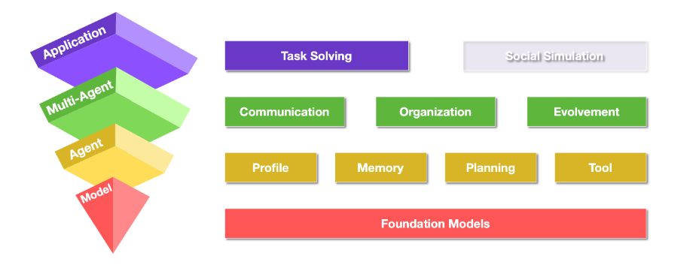
More attributes of an Agent
🤖 Autonomy: Collaborates and Decides.
🛠️Tools
🔄Self-reflection & Improvement
📅 Planning
💾 Memory
From https://thinkwee.top/multiagent_ebook/

